Slide 1
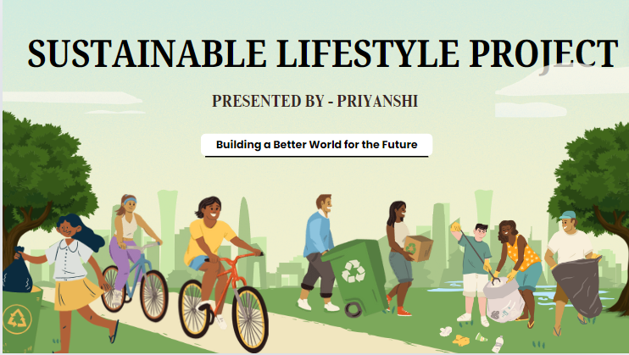

Slide 2
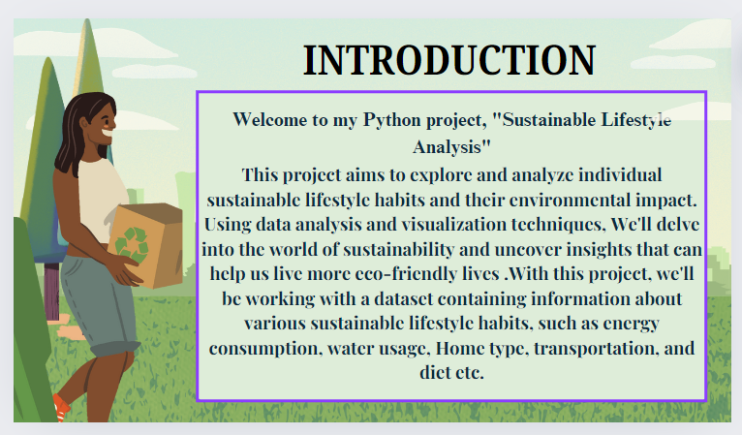

Slide 3
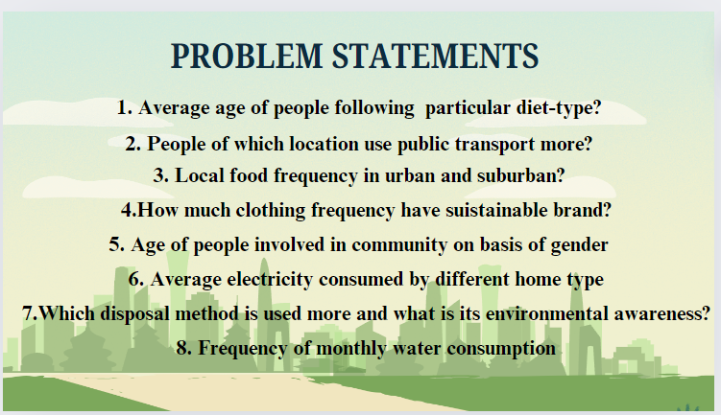

Slide 4
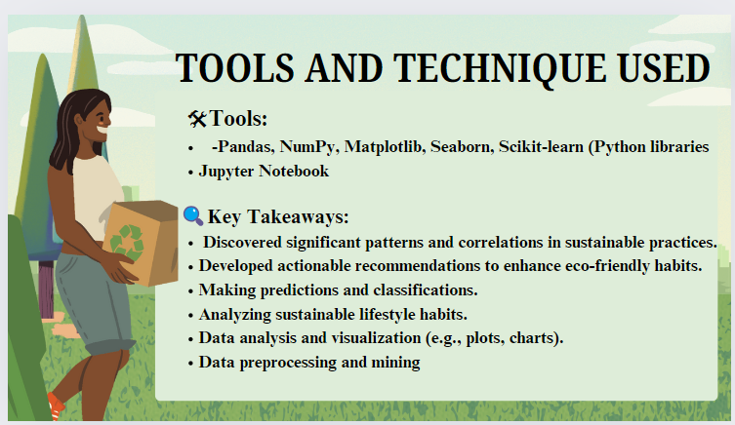

Slide 5

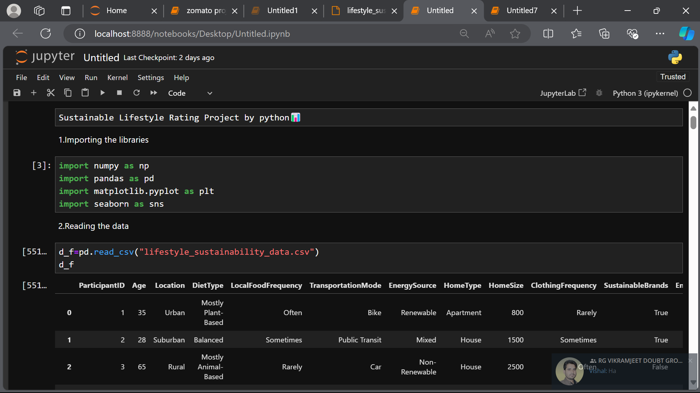
IMPORTING THE LIBRARIES-:
NUMPY , PANDAS - For data manipulation and analysis .
MATPLOTLIB-For data visualization.
READING THE DATA-:
pd.read_csv(“Lifestyle_sustainability _data.csv”)

Slide 6
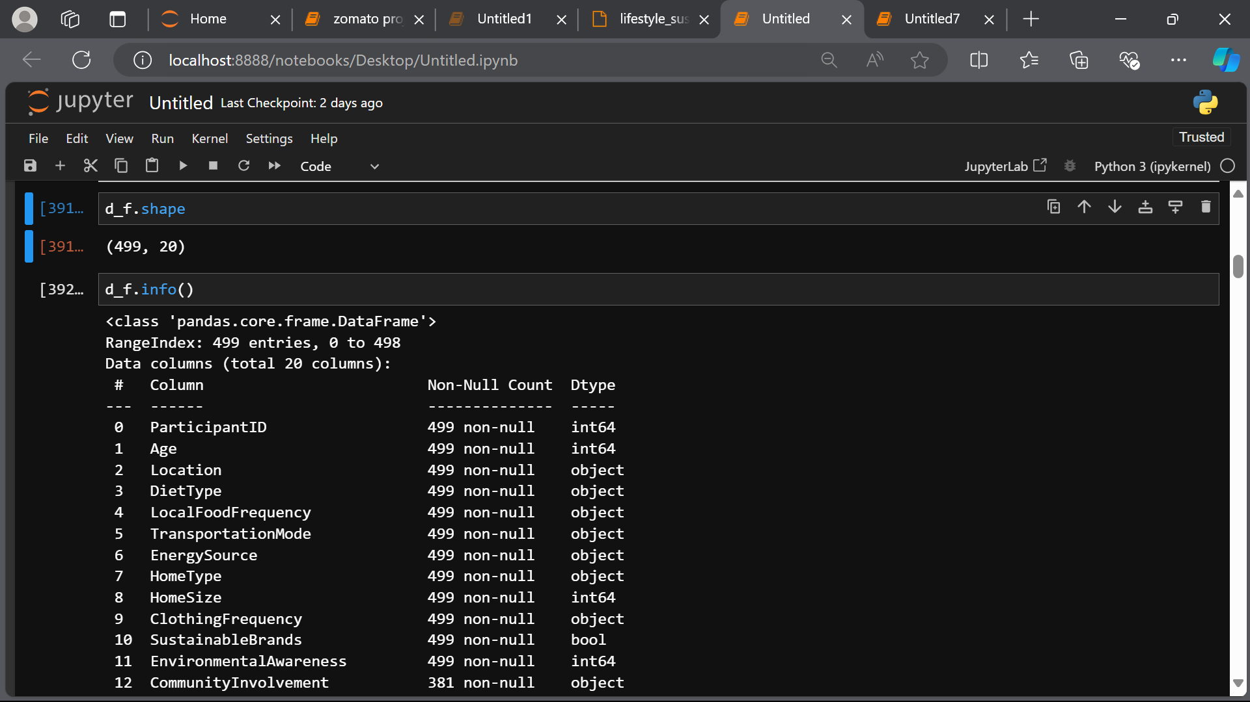
KNOWING THE STRUCTURE OR BASIC INFORMATION
1. Shape – rows and column in a dataset.
2. Info – the column name , its data type

Slide 7
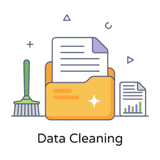
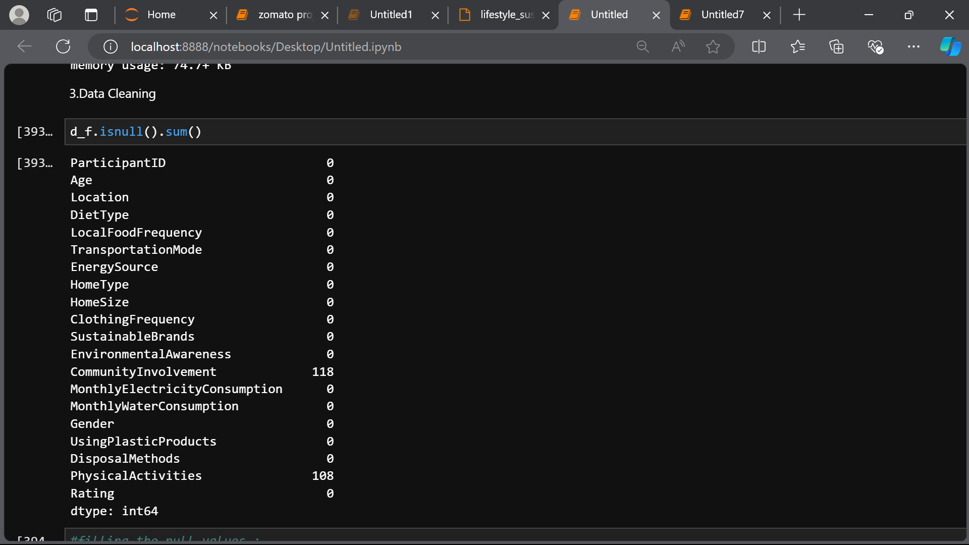
DATA CLEANING (FINDING THE NULL VALUES)
Data cleaning is an important step in preparing a dataset. It is used for various reasons-:
Improves accuracy
Enhance security.
Saves time.
Improving decision making process.

Slide 8
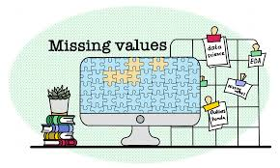
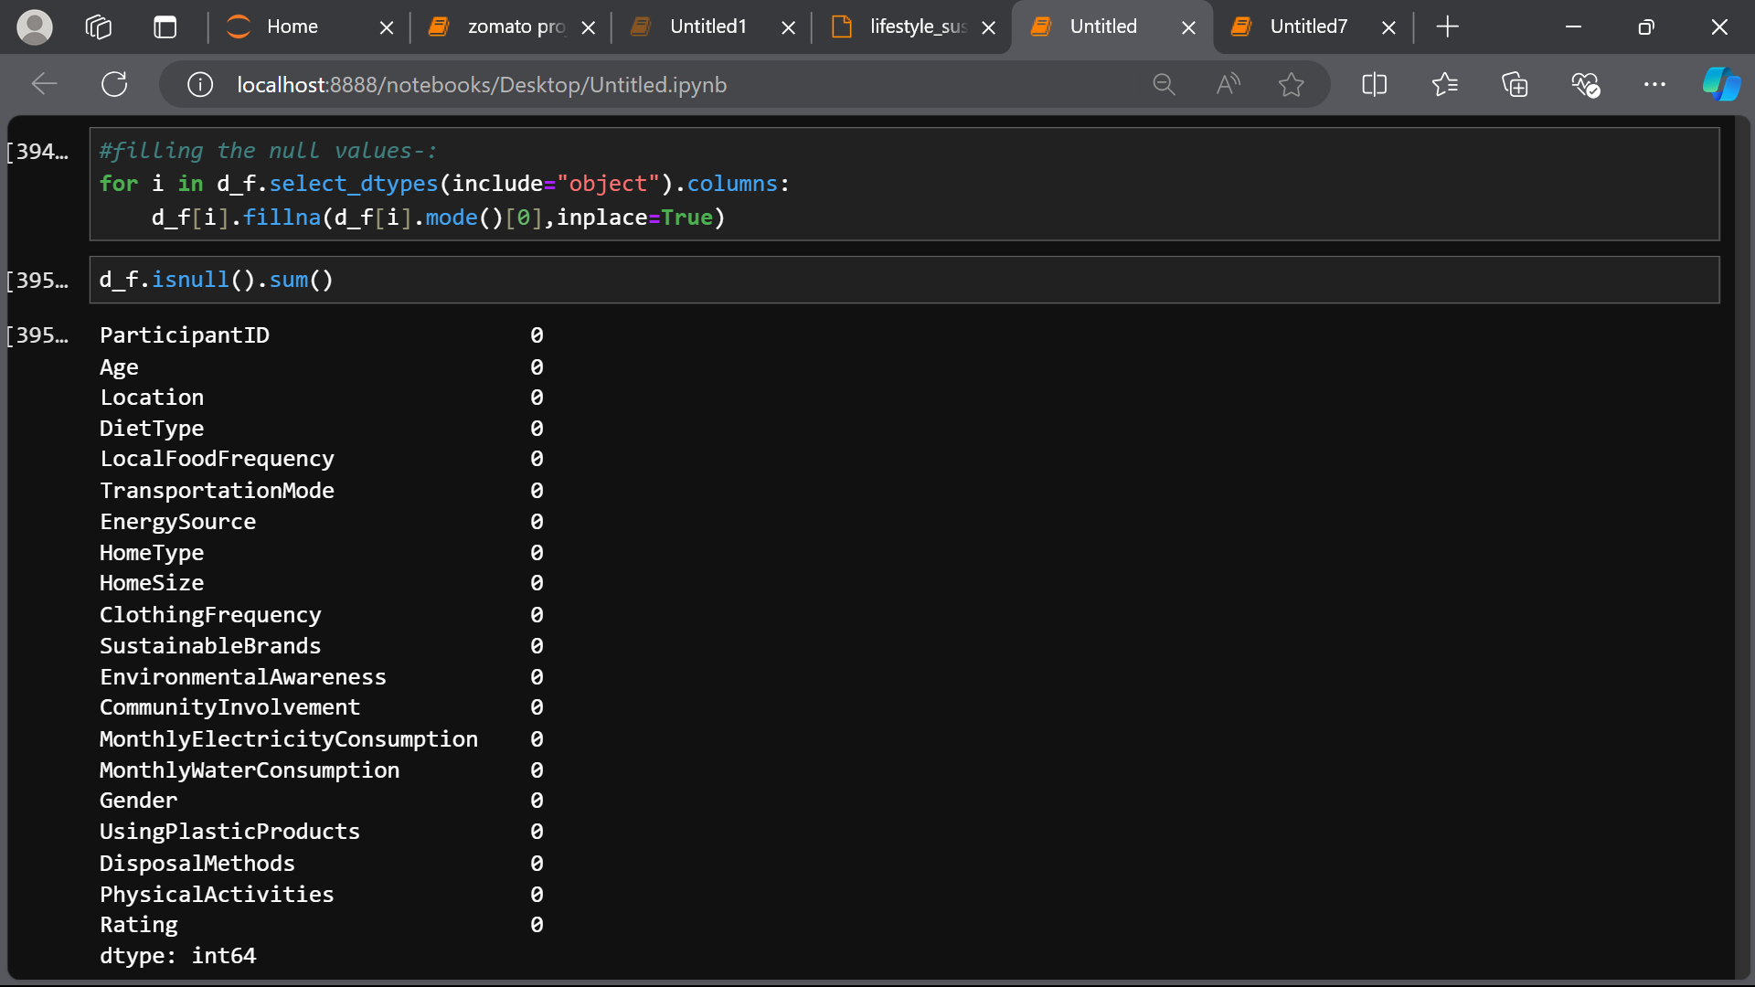
HANDLING THE MISSING VALUE
Using isnull()
This function is used to check whether there are null values
Using dropna()
This function is used to drop the rows having the null values from the dataset.
Using fillna( )
This function is used to fill the null values with the user defined value.

Slide 9
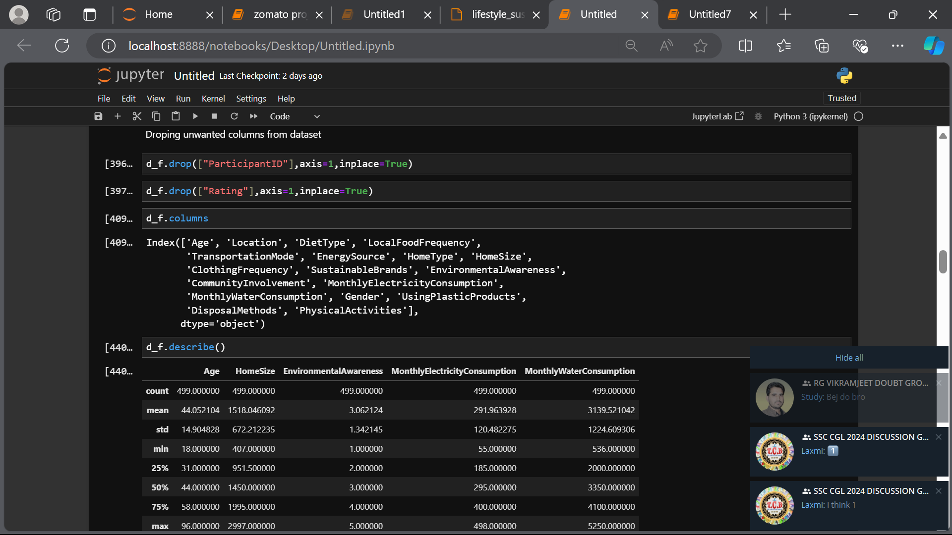
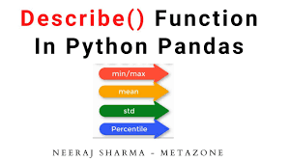
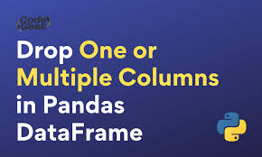
DROPPING THE COLUMNS FROM DATAFRAME
By dropping unwanted columns from the dataset ,we can focus on relevant data only , simplifies the data analysis, improves accuracy.
The describe() method is used for calculating some statistical data like percentile, mean and std of the numerical values of the Series or DataFrame.

Slide 10
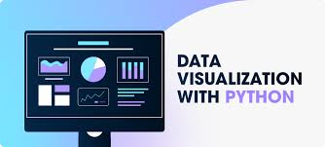
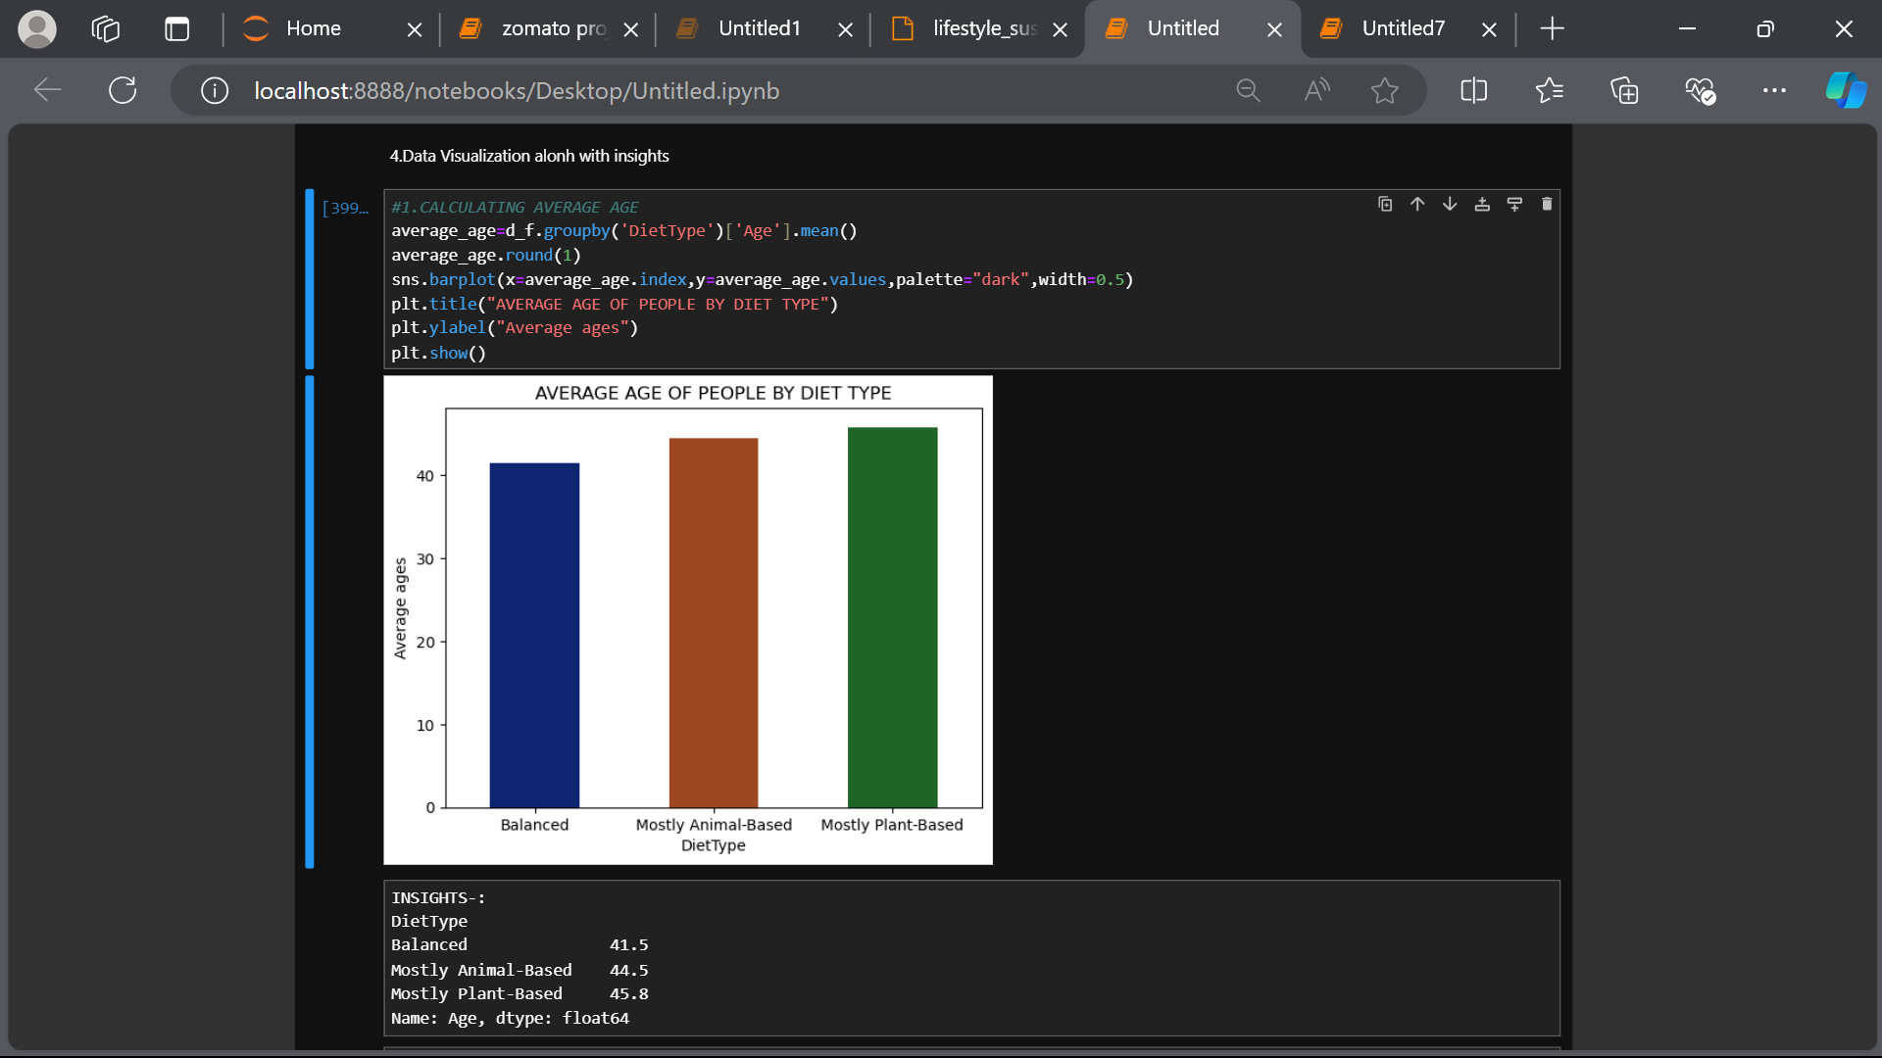
The process of finding trends and correlations in our data by representing it pictorially is Data Visualization. To perform data visualization in python, we can use various python data visualization modules such as Matplotlib, Seaborn, Plotly, etc.
Average age of people by their diet type.
CHART TYPE –Bar chart
ATTRIBUTES-
Title() – to show the title of chart.
ylabel() – to give y- axis a title.
RESULTS-:
Balanced - 41.5
Mostly Animal based - 44.5
Mostly Plant based - 45.8

Slide 11

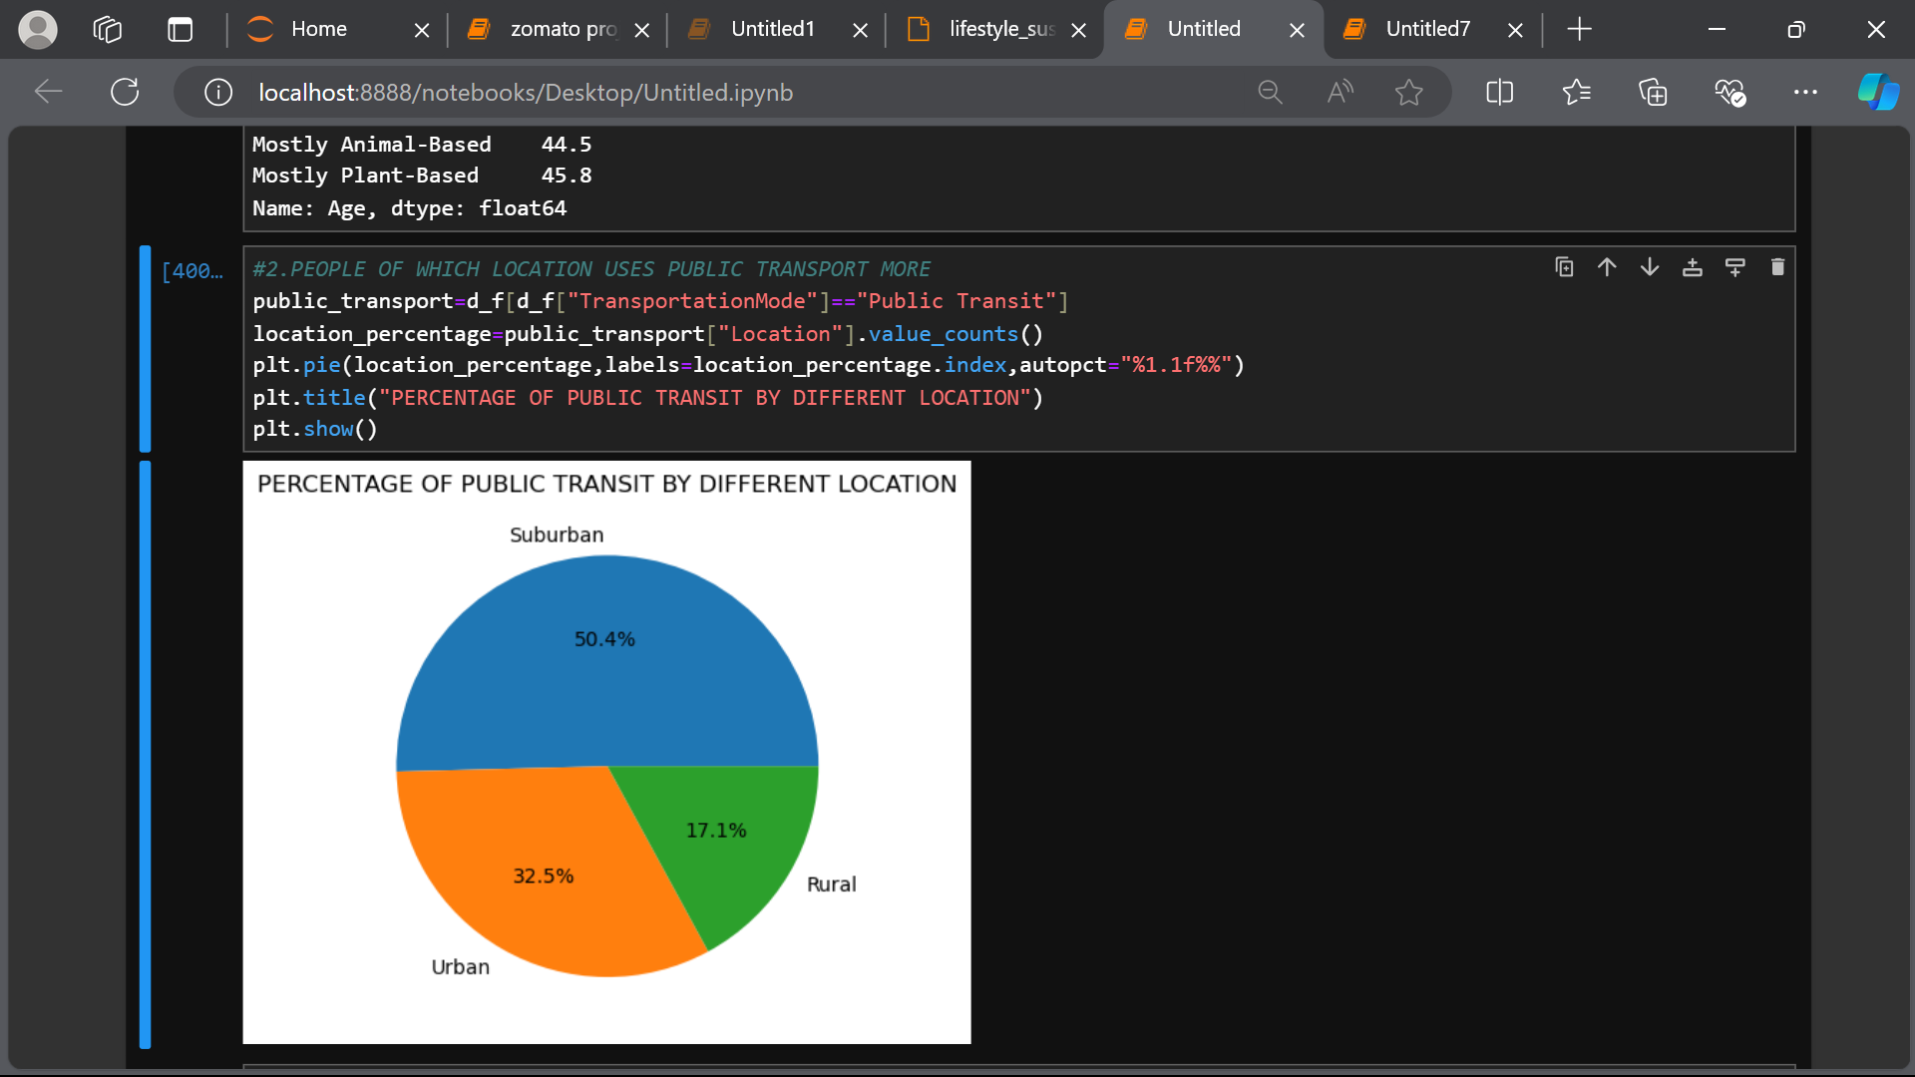
2. People of which area use the public transport more.
CHART TYPE –Pie chart
ATTRIBUTES-
Title() – to show the title of chart.
RESULTS-:
Urban – 32.5%
Suburban – 50.4%
Rural – 17.1%

Slide 12
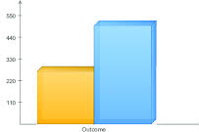
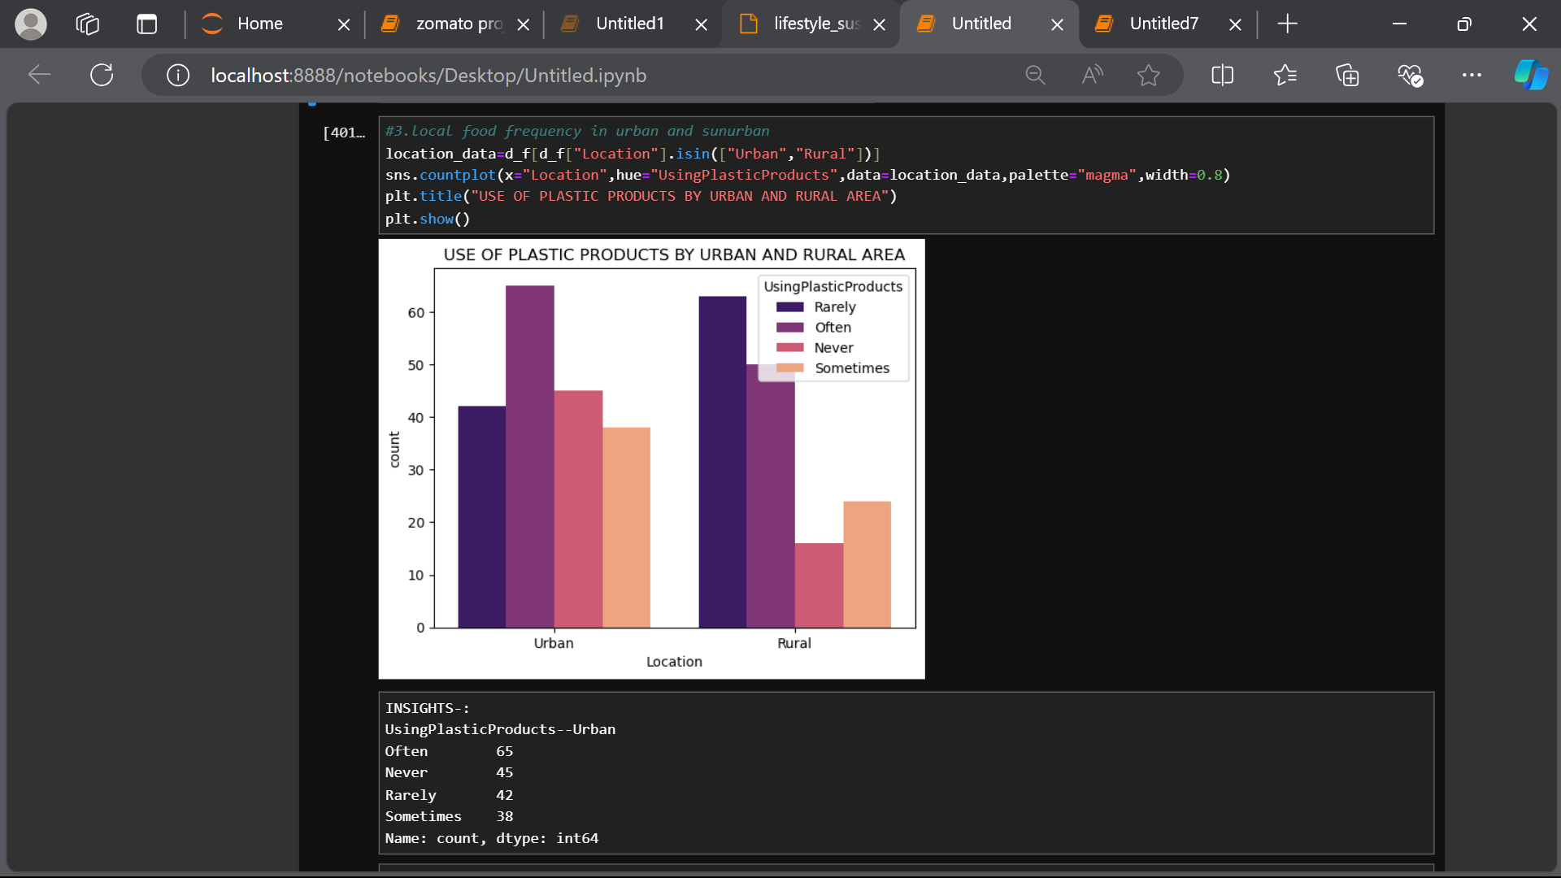
2. People of urban and rural using plastic product .
CHART TYPE –countplot chart
ATTRIBUTES-
Title() – to show the title of chart.
RESULTS-:
Often - 65
Never - 45
Rarely – 47
Sometimes - 38

Slide 13
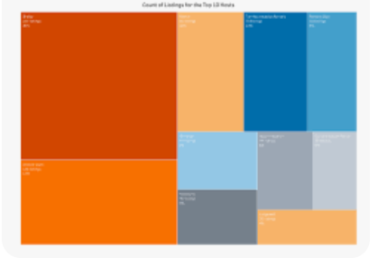
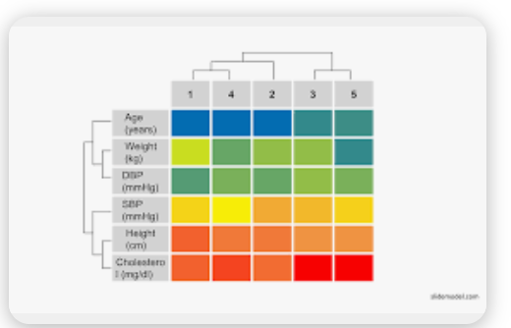
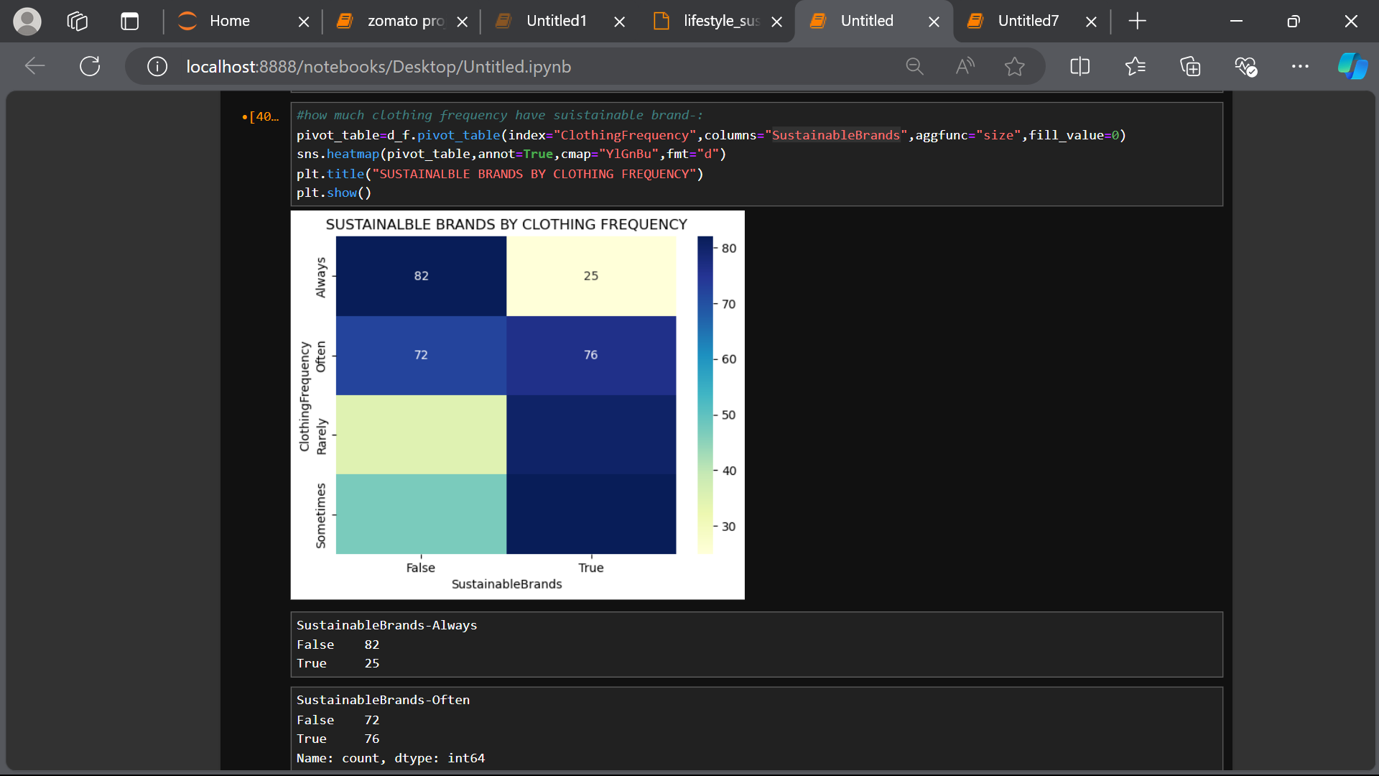
2. Clothing frequency of people have sustainable brands.
CHART TYPE – heatmap
ATTRIBUTES-
Title() – to show the title of chart
RESULTS-:
Sustainable Brands - Always
True 25
False 82
Sustainable Brands - Often
True 76
False 72
Sustainable Brands - Rarely
True 80
False 35
Sustainable Brands - Sometimes
True 82
False 44

Slide 14
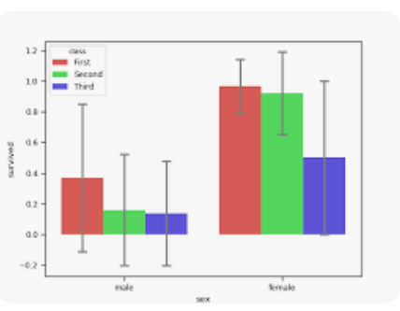
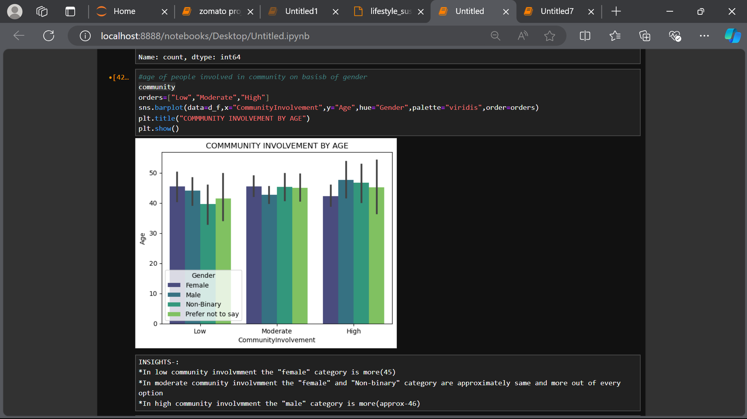
2. Clothing frequency of people have sustainable brands.
CHART TYPE – barplot
ATTRIBUTES-
Title() – to show the title of chart
RESULTS-:
Low community involvement the "female" category is more(45)
In moderate community involvement the "female“ , “Non-binary" category are approximately same and more out of every option.
In high community involvement the "male" category is more(approx-46)

Slide 15
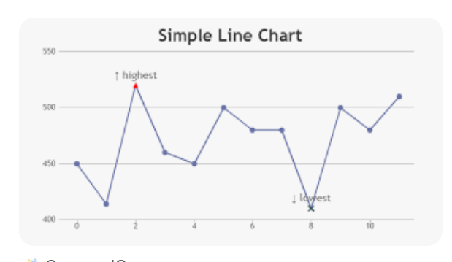
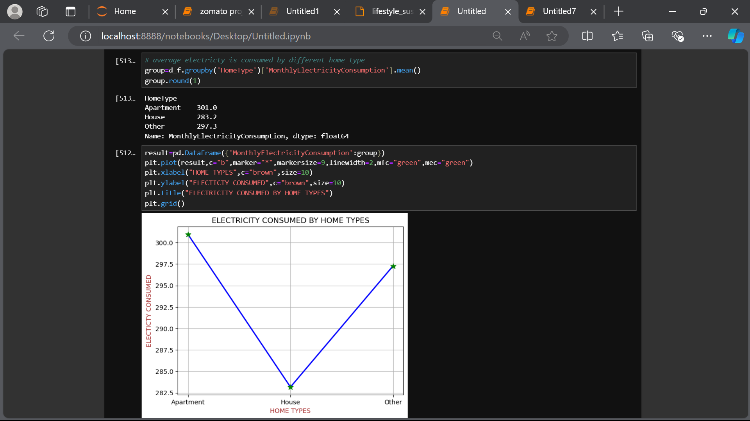
2. Average electricity consumed by different home type .
CHART TYPE – line chart
ATTRIBUTES-
Title() – to show the title of chart.
xlabel()- to give x-axis a title.
ylabel()- to give y-axis a title.
Grid() – to enable the gridlines on chart.
RESULTS-:
Apartment – 301.0
House – 283.2
Other – 297.1

Slide 16
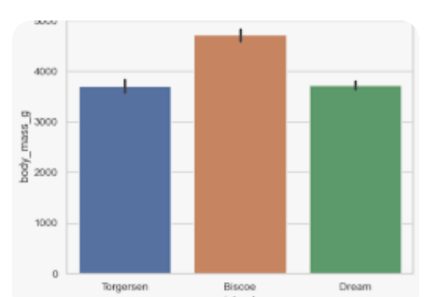
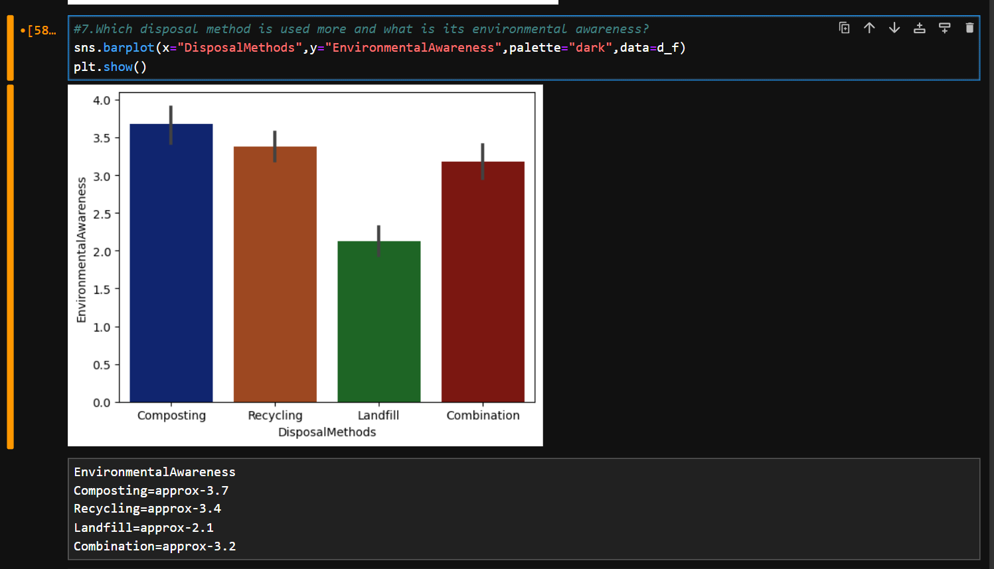
2. Which disposal method is used more and what is its environmental awareness?
CHART TYPE – barplot
RESULTS-:
Composting - approx3.7
Recycling - approx3.4
Combination - approx-3.2
Landfill - approx2.1

Slide 17
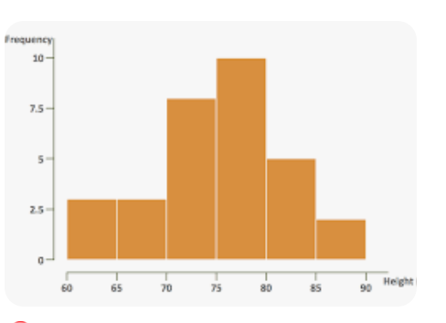
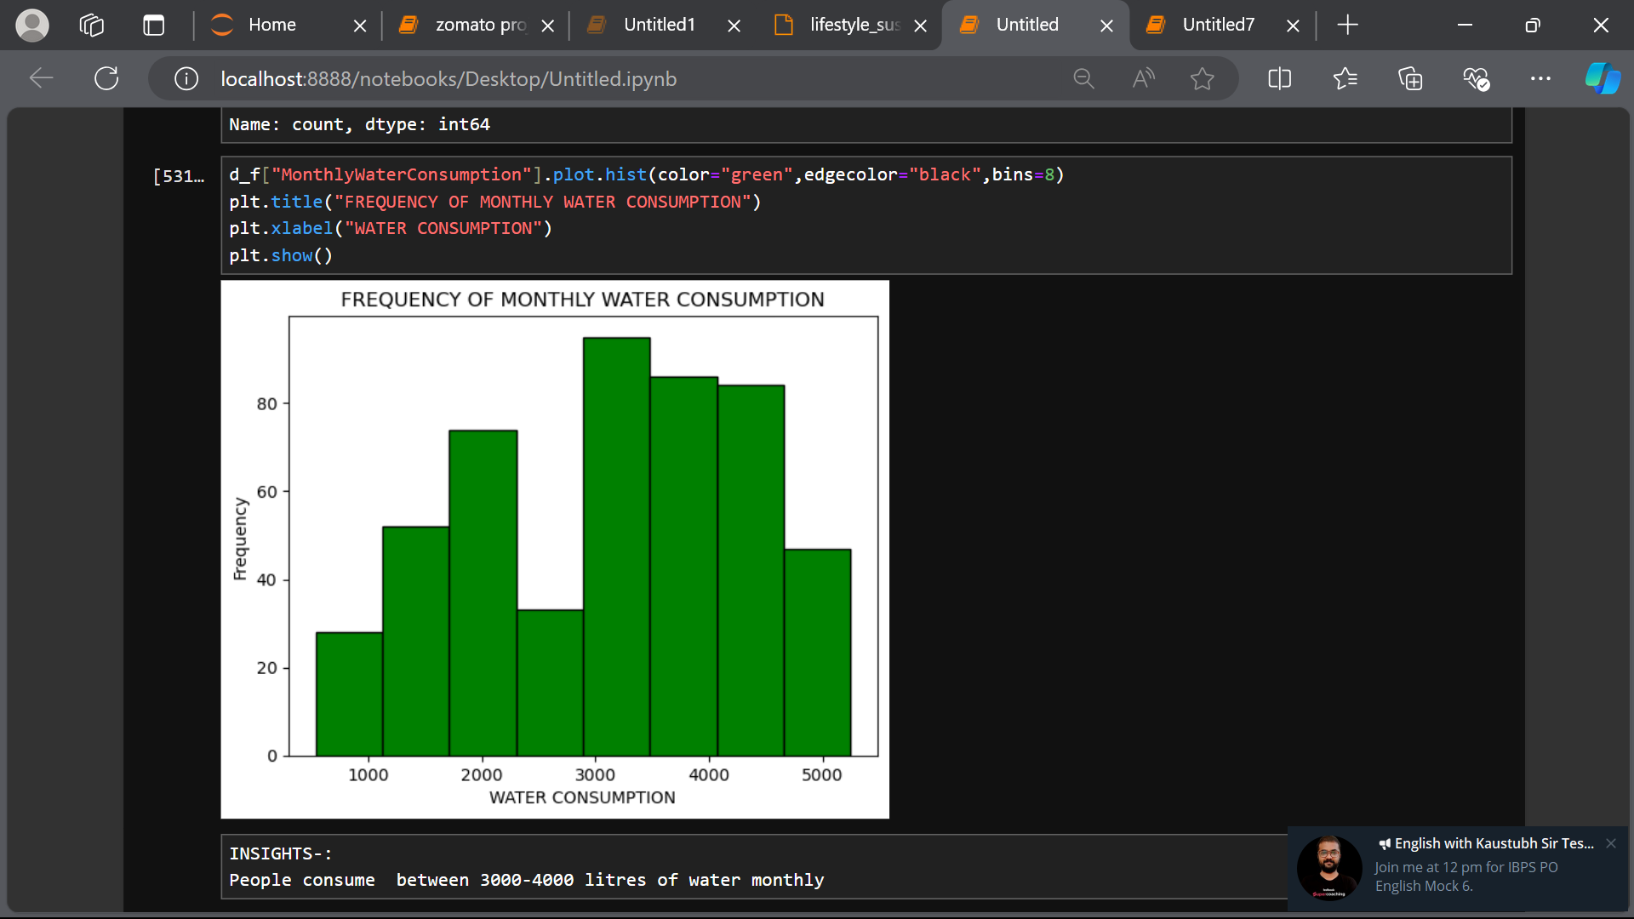
2. Frequency of Monthly water consumption.
CHART TYPE – histogram
ATTRIBUTES-
Title() – to show the title of chart.
xlabel() – to give x-axis a title.
RESULTS-:
People consume between 3000-4000 liters of water monthly

Slide 18




“As I wrapped up my Python project, I felt a sense of 'code accomplishment' - a rush of pride and satisfaction that comes from taming the chaos of code into a harmonious symphony of functionality. The journey was a rollercoaster of emotions, from the thrill of 'aha!' moments to the agony of debugging despair. Yet, with each hurdle cleared, my confidence grew, and my coding superpowers expanded.
My mind expanded as I grasped the versatility of Python, and my creativity soared as I brought ideas to life.
In the end, this project was a transformative odyssey that not only taught me Python but also revealed the power of perseverance, the thrill of learning, and the joy of creating something from scratch. As I close this chapter, I'm eager to embark on the next adventure, armed with my newfound skills.”
--- THANKYOU ---

